Slide 1
JSP :Custom Tag

Slide 2
Custom Tag
User-defined tags are known as custom tags.
To create a custom tag we need three things: 1) Tag handler class: In this class we specify what our custom tag will do when it is used in a JSP page. 2) TLD file: Tag descriptor file where we will specify our tag name, tag handler class and tag attributes. 3) JSP page: A JSP page where we will be using our custom tag.

Slide 3
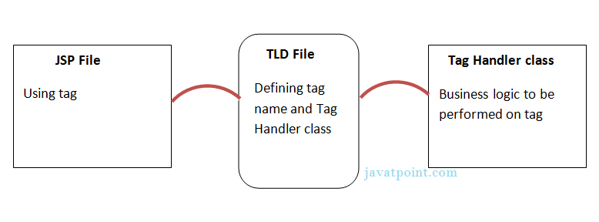
Custom Tag

Slide 4
Steps to Create Custom Tag
Example : we are creating a custom tag HelloTag which will display the message “ Hello Custom Tag”
Step 1: Tag handler class:
A tag handler class should implement Tag/IterationTag/ BodyTag interface or it can also extend TagSupport/BodyTagSupport/SimpleTagSupport class.
All the classes that support custom tags are present inside javax.servlet.jsp.tagext.
In the example we are extending the class SimpleTagSupport.
package customTag;
import javax.servlet.jsp.tagext.*;
import javax.servlet.jsp.*;
import java.io.*;
public class Details extends SimpleTagSupport {
public void doTag() throws JspException, IOException {
JspWriter out = getJspContext().getOut();
out.println("Hello Custom Tag!");
}
}

Slide 5
Steps to Create Custom Tag
Step 2: Create tld file (mytags.tld)
This file should present at the location: Project Name/WebContent/WEB-INF/ and it should have a .tld extension.
<taglib>
<tlib-version>1.0</tlib-version>
<jsp-version>2.0</jsp-version>
<short-name>Custom Tag Example </short-name>
<tag>
<name>HelloTag</name>
<tag-class> customTag.Details</tag-class>
<body-content>empty</body-content>
</tag>
</taglib>
Note:
<name> tag: custom tag name.
<tag-class> tag: Fully qualified class name. Our tag handler class Details.java is in package so we have given the value as customTag.Details

Slide 6
Steps to Create Custom Tag
Step 3: Using custom tag in JSP (Create JSP file customTag.jsp)
We will use HelloTag in JSP file
Note: taglib directive should have the TLD file path in uri field. Above we have created the message.tld file so we have given the path of that file.
Choose any prefix and specify it in taglib directive’s prefix field. Here we have specified it as myprefix.
Custom tag is called like this: <prefix:tagName/>. Our prefix is myprefix and tag name is MyMsg so we have called it as <myprefix:MyMsg/> in the below JSP page.
<taglib>
<tlib-version>1.0</tlib-version>
<jsp-version>2.0</jsp-version>
<short-name>Custom Tag Example </short-name>
<tag>
<name>HelloTag</name>
<tag-class> customTag.Details</tag-class>
<body-content>empty</body-content>
</tag>
</taglib>

Slide 7
package customTag;
import javax.servlet.jsp.tagext.*;
import javax.servlet.jsp.*;
import java.io.*;
public class Details extends SimpleTagSupport {
public void doTag() throws JspException, IOException {
JspWriter out = getJspContext().getOut();
out.println("Hello Custom Tag!");
}
}
doTag() method takes the current JspContext object using the getJspContext() method and uses it to send “Details Custom Tag!" to the current JspWriter object

